Slide 1
Data Transfer Schemes

Slide 2
Data Transfer Schemes
Data is transferred between
Microprocessor and memory
Microprocessor and I/O
Memory and I/O

Slide 3
Classification
Parallel and Serial
Parallel classified as:
Programmed I/O
Synchronous
Asynchronous
Interrupt driven
Direct Memory Access
Burst mode
Cycle stealing mode
Serial classified as:
Using hardware
Using software

Slide 4
Programmed Data Transfer
Used when relatively small amount of data is to be transferred between slow devices
Can be classified as
Synchronous Transfer
Asynchronous Transfer
Interrupt driven data transfer

Slide 5
Synchronous Data Transfer
Simplest
Used when the speed of the device is almost compatible with that of the processor
Whenever data is needed suitable instruction is issued
By the end of the execution of the instruction the transfer would be completed
Used when the timing characteristics of the device is known

Slide 6
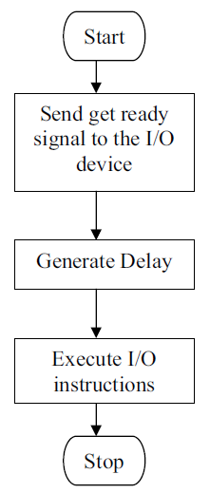
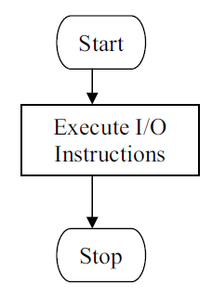

Slide 7
Asynchronous Data Transfer
Used when the speed of microprocessor and I/O devices do not match
Microprocessor initiates the data transfer by requesting the device to get ready
Then it goes on checking the status
When the device is ready it sends an acknowledgement
Handshaking
A lot of CPU time wasted in the loop checking the status

Slide 8
Start
Send get ready signal to the I/O device
Is the Device ready?
No
Yes
Execute I/O instructions
Stop

Slide 9
Interrupt Driven Data Transfer
The processor initiates the data transfer by requesting the device to get ready
It then goes on executing its original program
When the device is ready it sends an interrupt signal to the processor
Processor completes the current instruction, saves the status in the stack and branches to the ISS

Slide 10
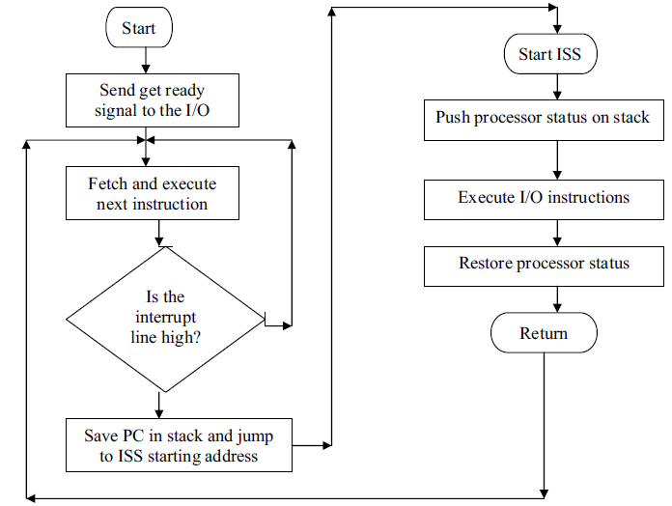

Slide 11
DMA Data Transfer
Burst Mode
Cycle Stealing

Slide 12
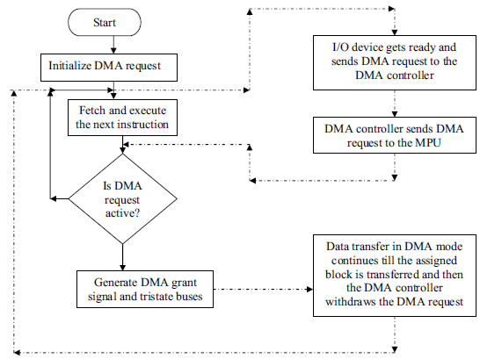

Slide 13
Serial
Using software: RIM ,SIM instructions
Hardware
Using USART 8251

